Slide 1
Notes:
Just the BG

Slide 2


Notes:
Before Grouping the Glass shapes

Slide 3
Notes:
After Grouping and changing the bordar radius of glass shapes

Slide 4







Notes:
Common for all pages

Slide 5
Notes:
Common for all pages – Shadow applied for the Glass look

Slide 6

AgriData Explorer
Notes:
Home Page PG

Slide 7
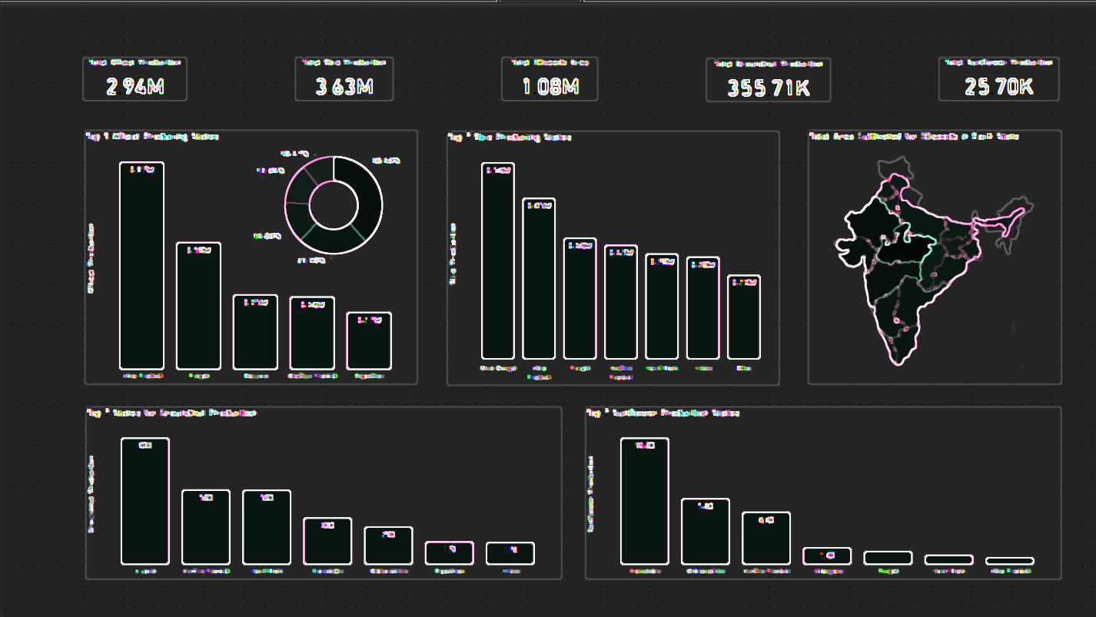





Notes:
Page 1 ‘s BG

Slide 8
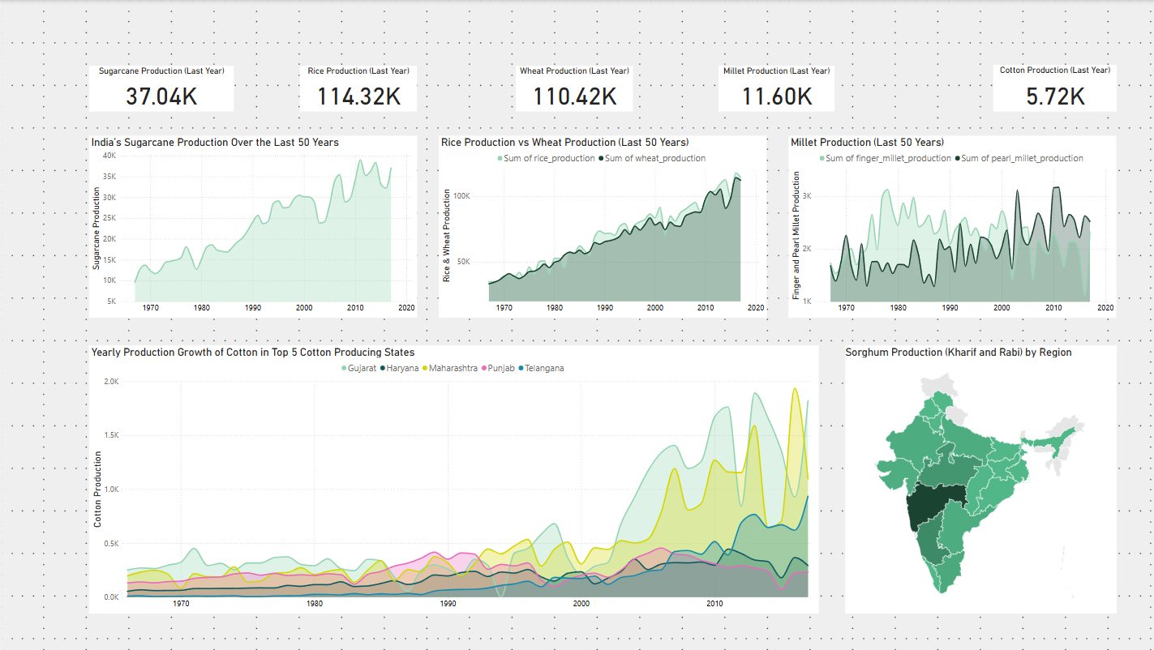



Notes:
Page 2 ‘s BG

Slide 9
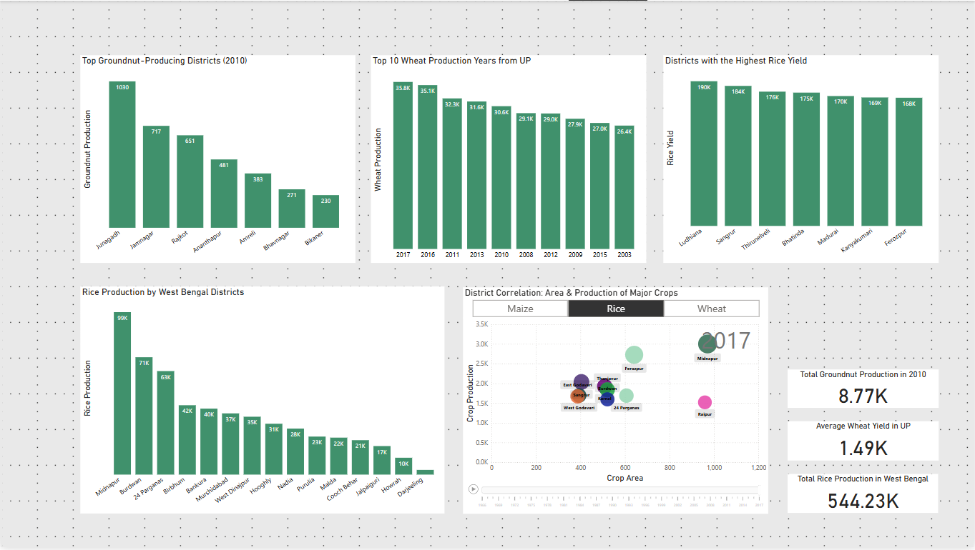
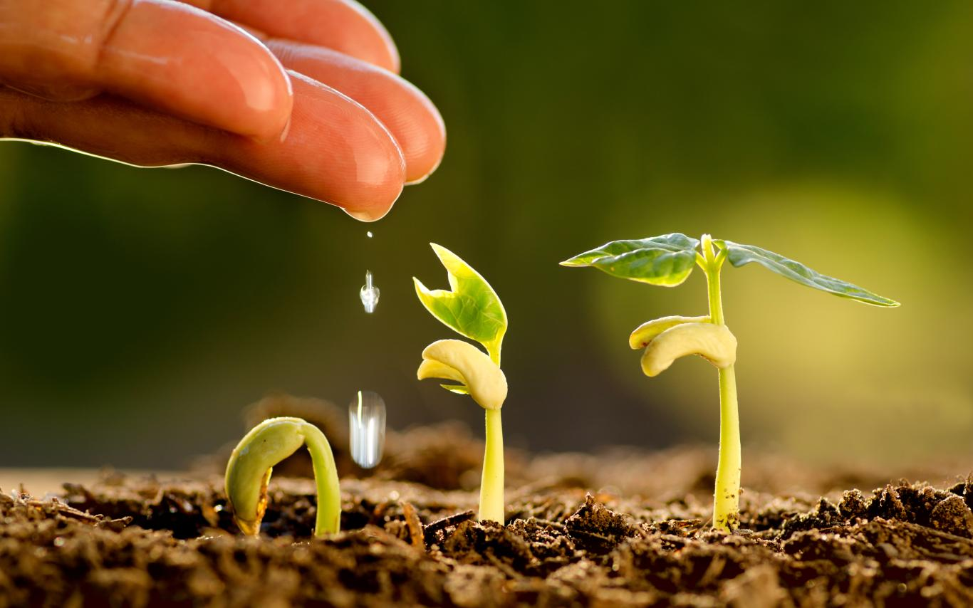
Notes:
Page 3 ‘s BG

Slide 10
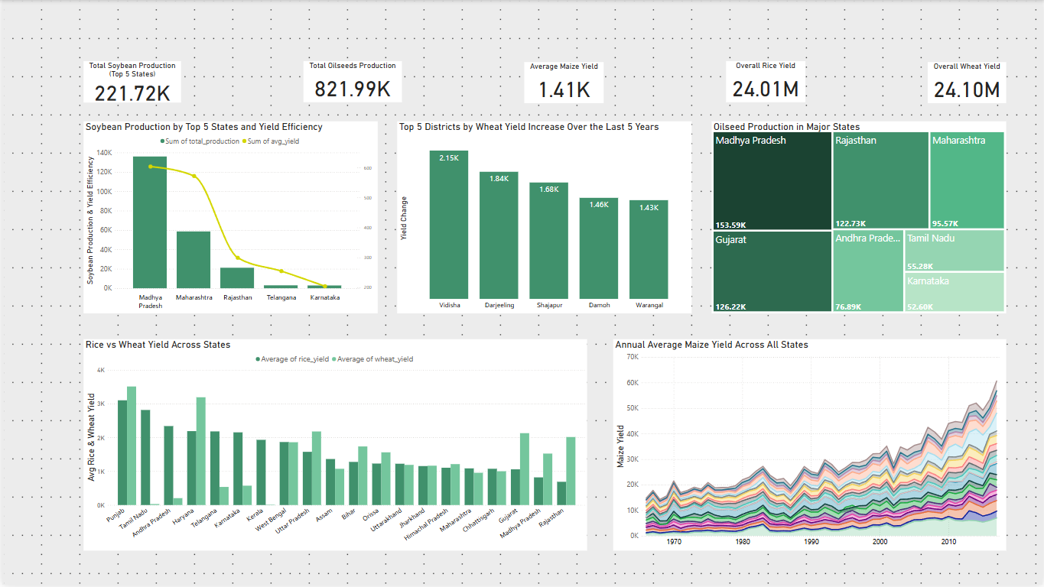


Notes:
Page 4 ‘s BG

Slide 11
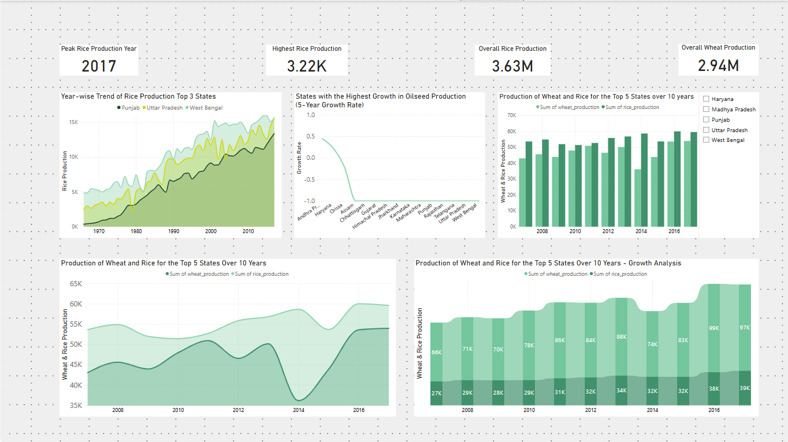


Notes:
Page 5 ‘s BG

Slide 12
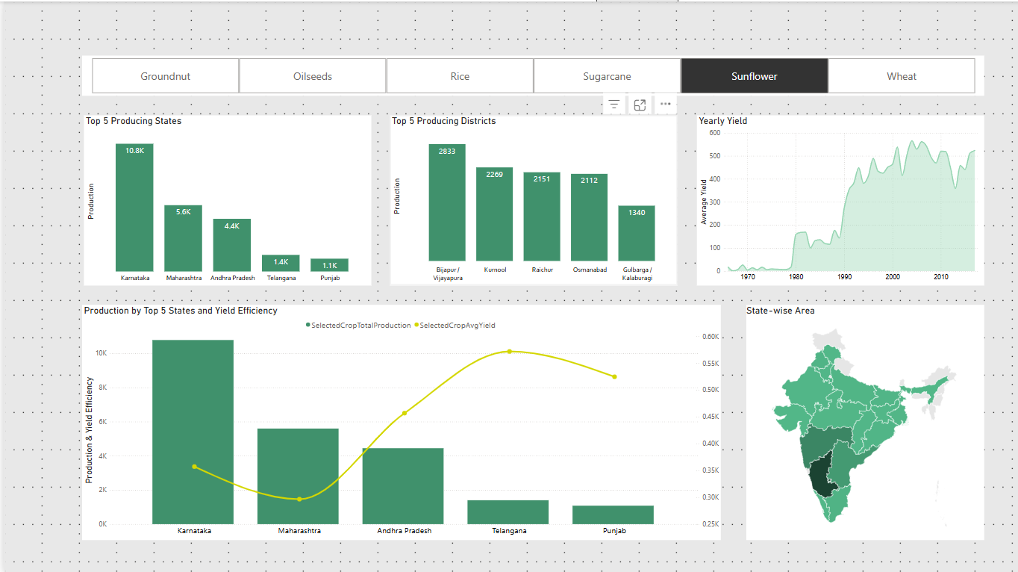
Notes:
Page 6 ‘s BG

